Slide 1
My Home Library
By Cati Kujawski
Notes:
https://lisabalbach.com/kujawsc/CIT228/Lesson11/

Slide 2
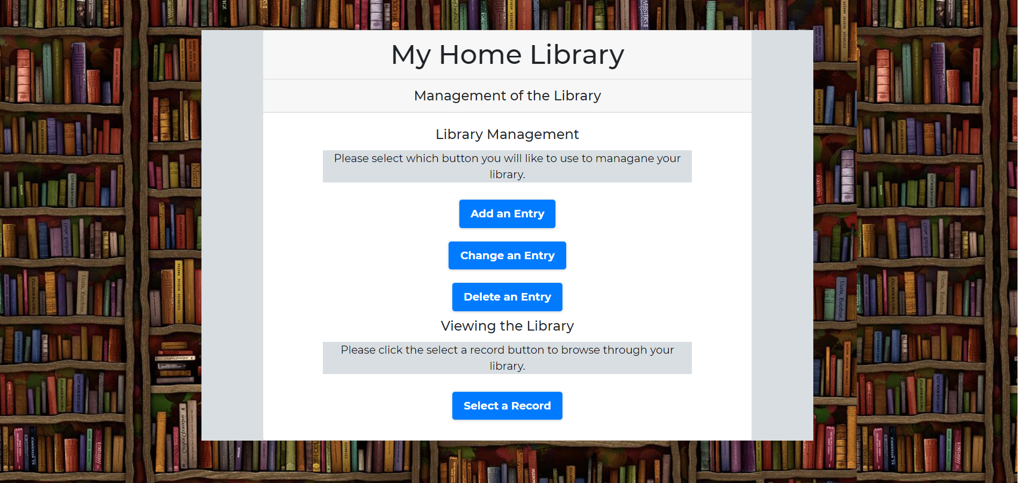
Introduction
of my website

Slide 3
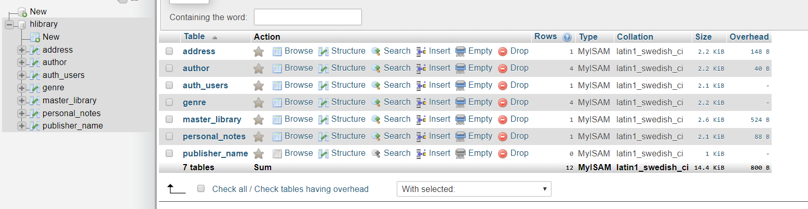
MySQL Tables

Slide 4
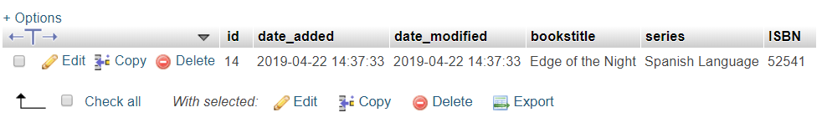
Master_library

Slide 5
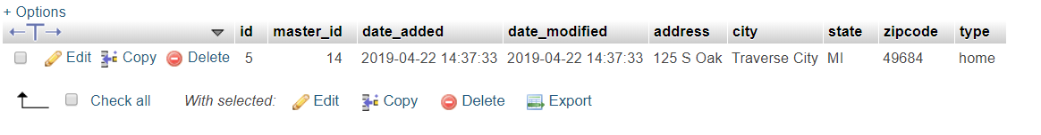
Address Table

Slide 6
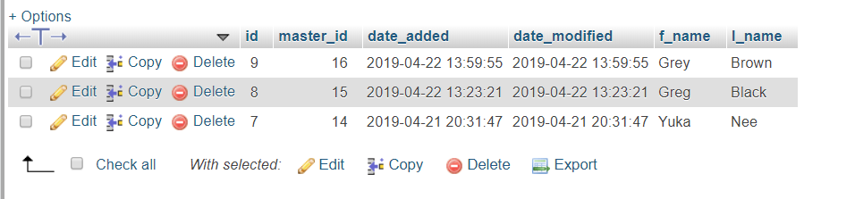
Author Table

Slide 7
My Code
HTML
PHP
XML
Bootstrap

Slide 8
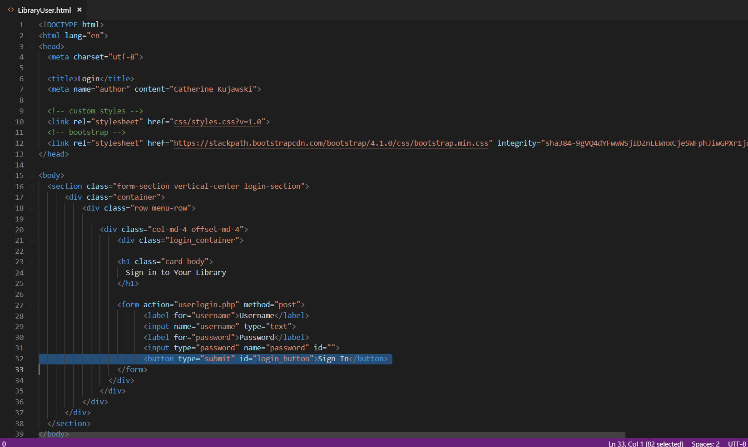
User Login

Slide 9
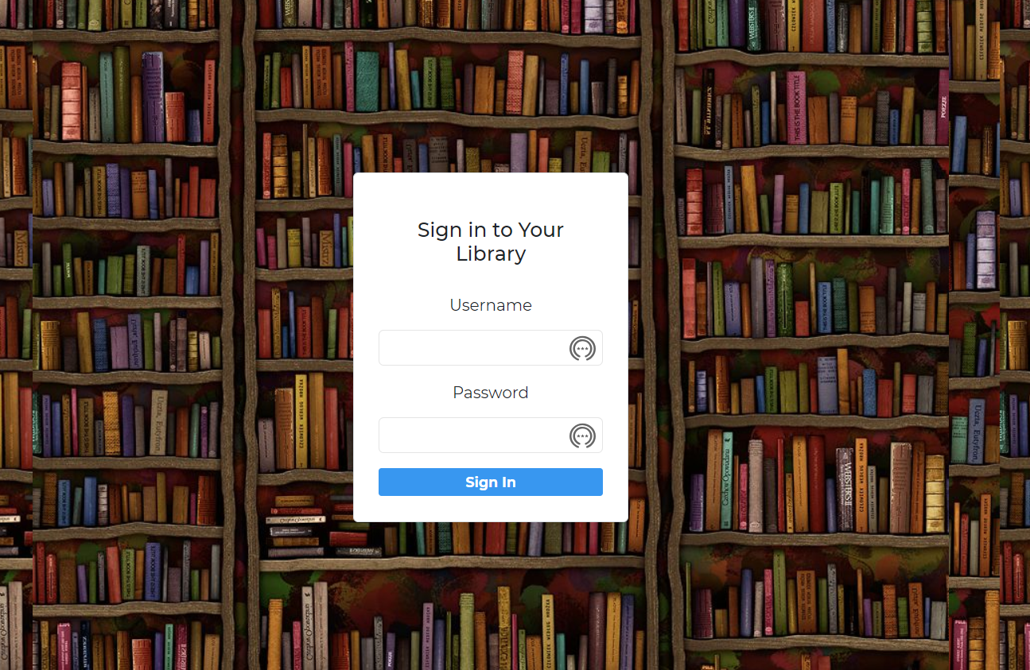

Slide 10
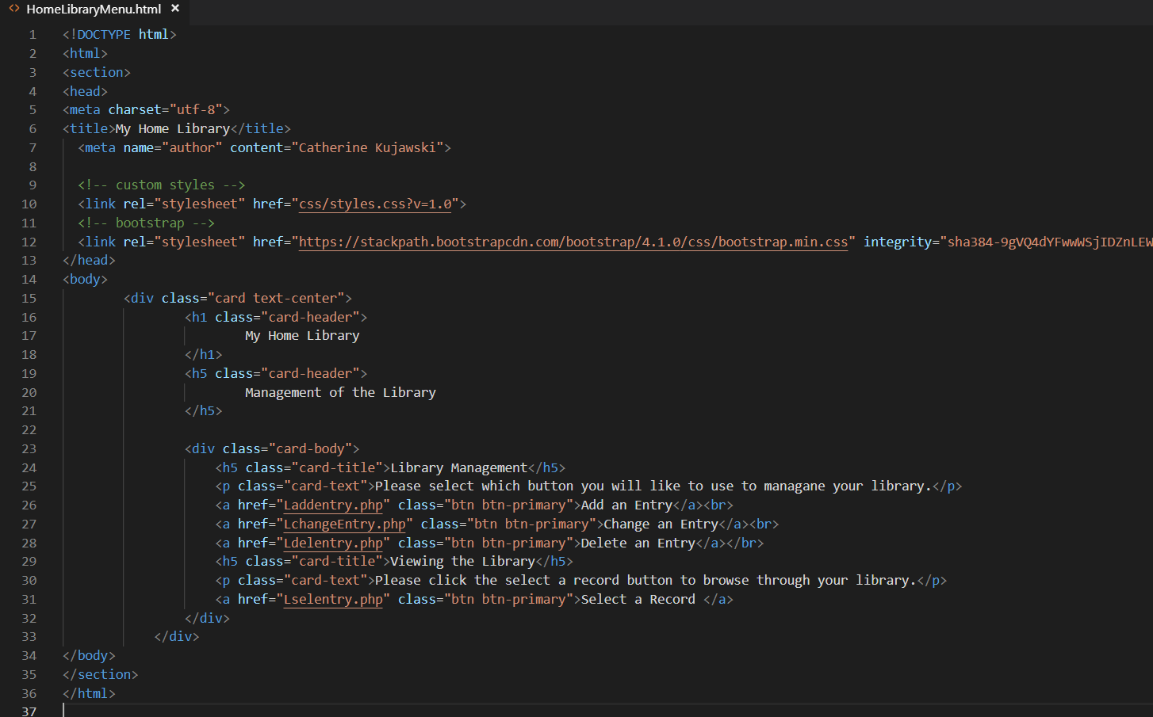
Home Library Menu

Slide 11
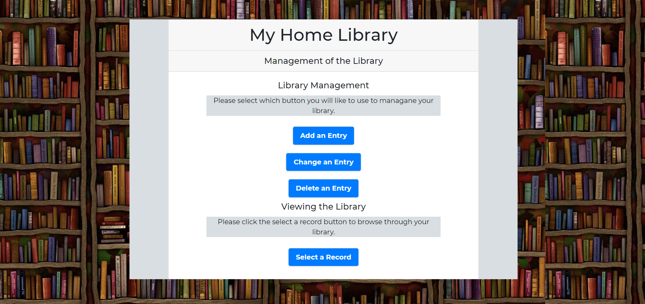
Notes:
https://lisabalbach.com/kujawsc/CIT228/Lesson11/

Slide 12

Mobile friendly

Slide 13
Conclusion
How to work with MySQL and how I could add data in to my database.
Authentication and XML
Learn what I could do and could not do with PHP
And be patient when it come to coding this project.

Slide 14
Questions

